Slide 1
Moby Dick
By Herman Melville

Slide 2

Moby Dick, novel by Herman Melville, published in London in October 1851 as The Whale and a month later in New York City as Moby-Dick; or, The Whale.
Moby Dick is generally regarded as Melville’s magnum opus and one of the greatest American novels.

Slide 3
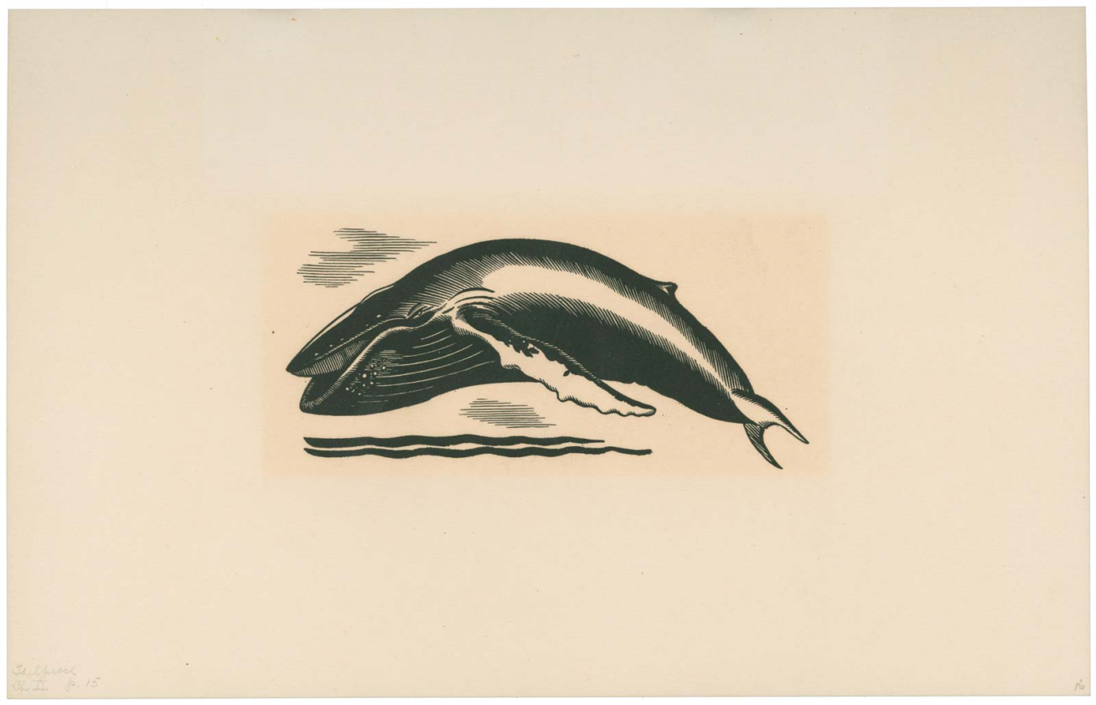
It’s a well-known novel about a captain's hunt for a sperm whale, is packed with vulgar jokes, while also delving into serious topics. Explore the story's characters, plot, and crude humor, along with the dark romantic elements highlighting the symbols, allegories, and themes of evil and vengeance.

Slide 4
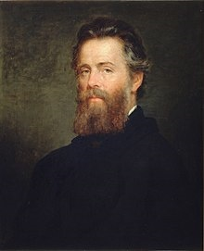
Herman Melville
(1819 - 1891)
was an American novelist, short story writer, and poet. Among his best-known works are Moby-Dick (1851), Typee (1846), and Billy Budd, Sailor.

