Slide 1
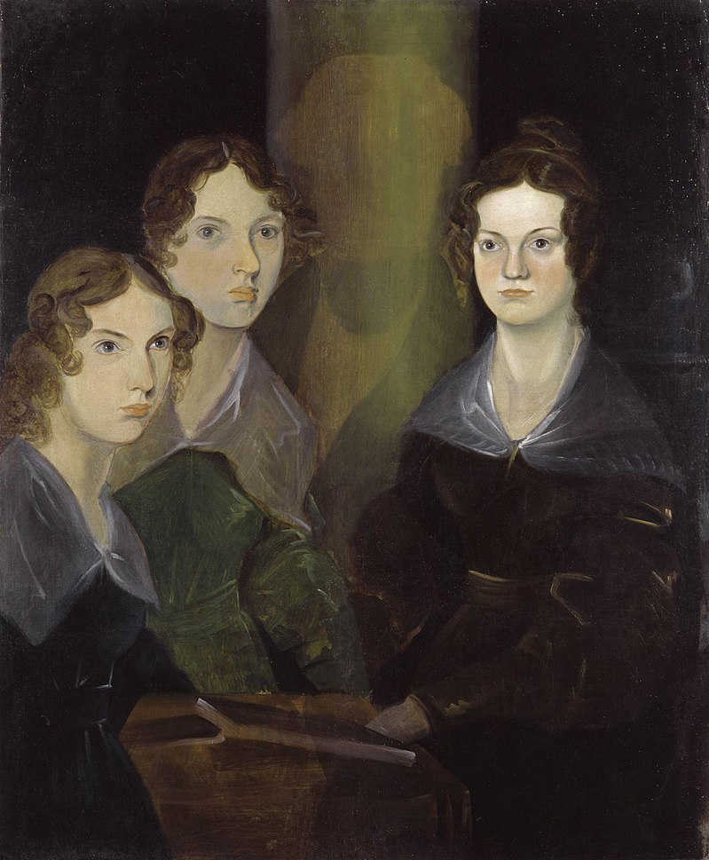
The sisters Brontё
Charlotte (1816–1855)
Emily (1818–1848)
Anne (1820–1849)

Slide 2
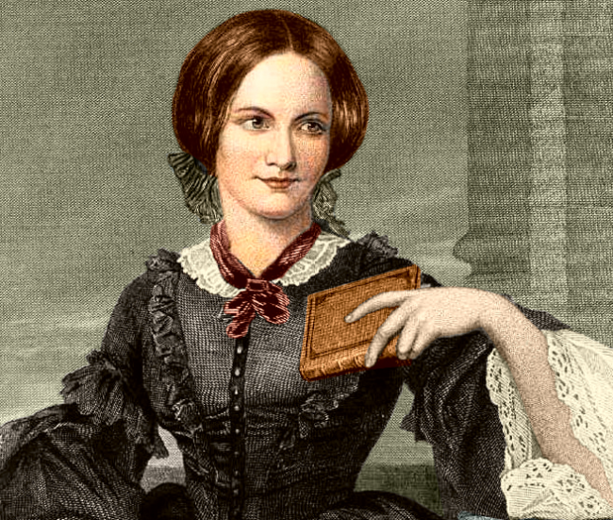
Charlotte's Jane Eyre
It is a story of Jane, a simple girl as she battles through life's struggles. Jane lives with her cruel Aunt Reed, goes to Lowood school, start working at the house of MrRochester and falls in love with him.

Slide 3
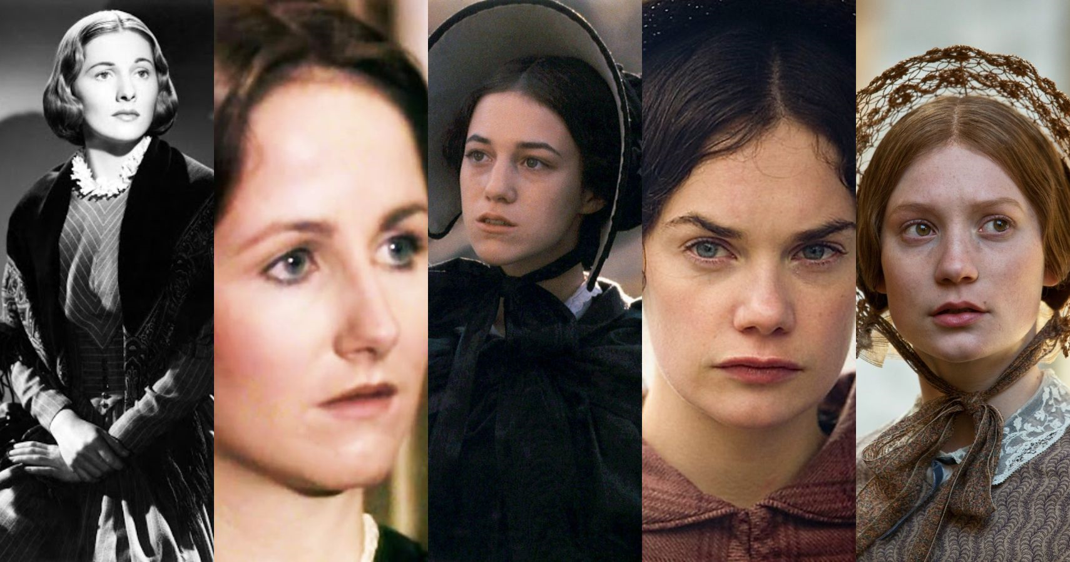
10 best Jane Eyre films

Slide 4
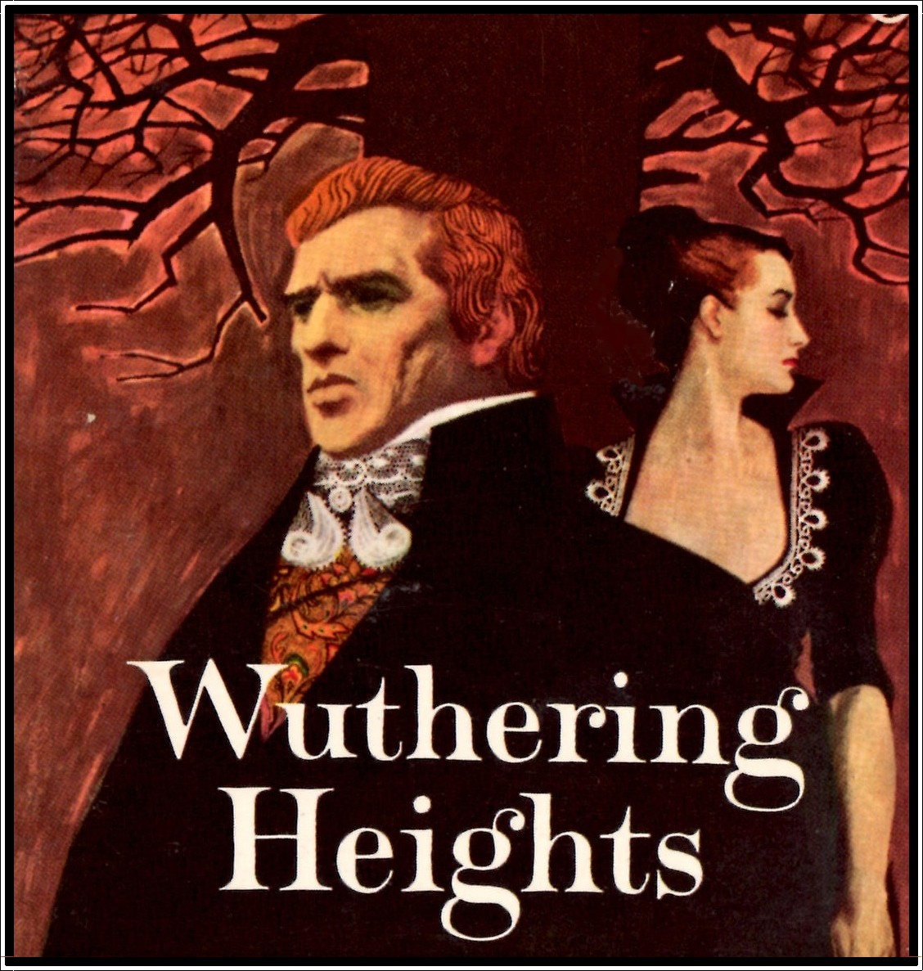
Emily's Wuthering Heights
(Грозовой перевал)
The book tells about two families, the Earnshaws and the Lintons, and their relationships with Earnshaw's adopted son, Heathcliff.

Slide 5
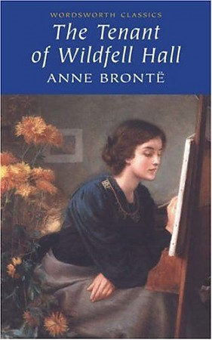
Anne's The Tenant of Wildfell Hall (Незнакомка из Уайлдфелл-Холла)
This is the story of a woman's struggle for independence. Helen has returned to Wildfell Hall in flight from a disastrous marriage, adopted an assumed name and earns her living as a painter.

