Slide 1
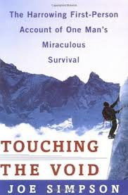
Touching the Void (1988)
is a 1988 book by Joe Simpson, recounting his and Simon Yates's near fatal descent after climbing the 6,344-metre peak Siula Grande in the Peruvian Andes. Approximately 15% of the book is written by Yates. It has sold over a million copies and has been translated into over 20 languages.

Slide 2
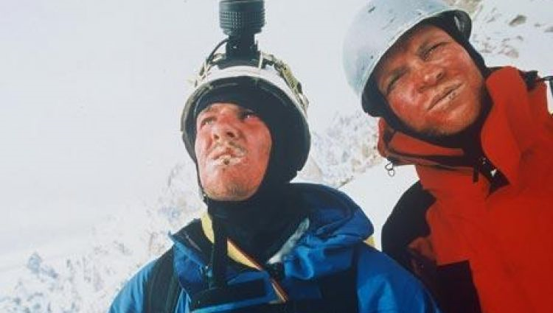
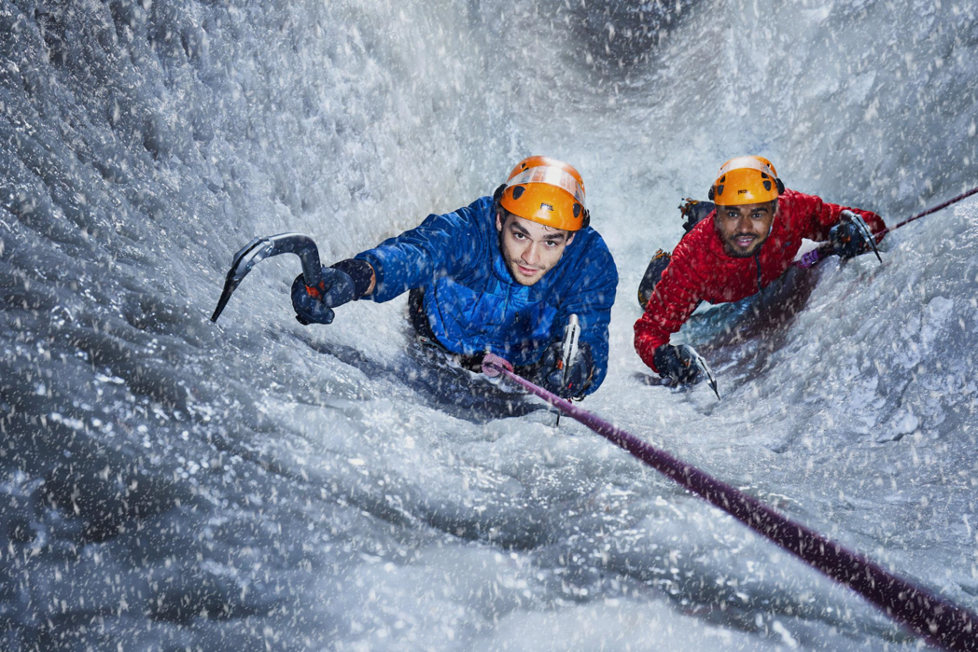
Touching the Void is a 2003 docudrama survival film directed by Kevin Macdonald

Slide 3
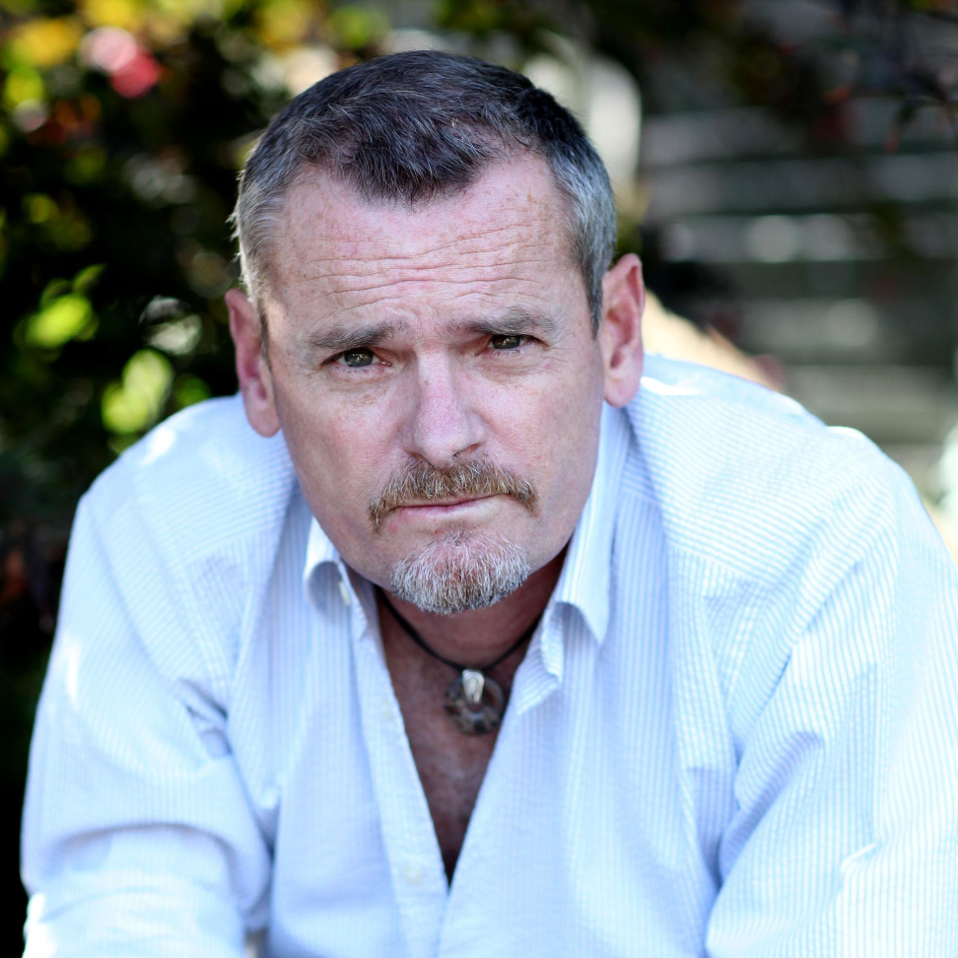
Joe Simpson
(born 1960)
a British mountaineer and author. While climbing in Peru in 1985, he suffered severe injuries and was thought lost after falling into a crevasse, but he survived and managed to crawl back to his base camp. He described it in his best-selling 1988 book Touching the Void, which was adapted into a 2003 documentary film of the same name.

