Slide 1
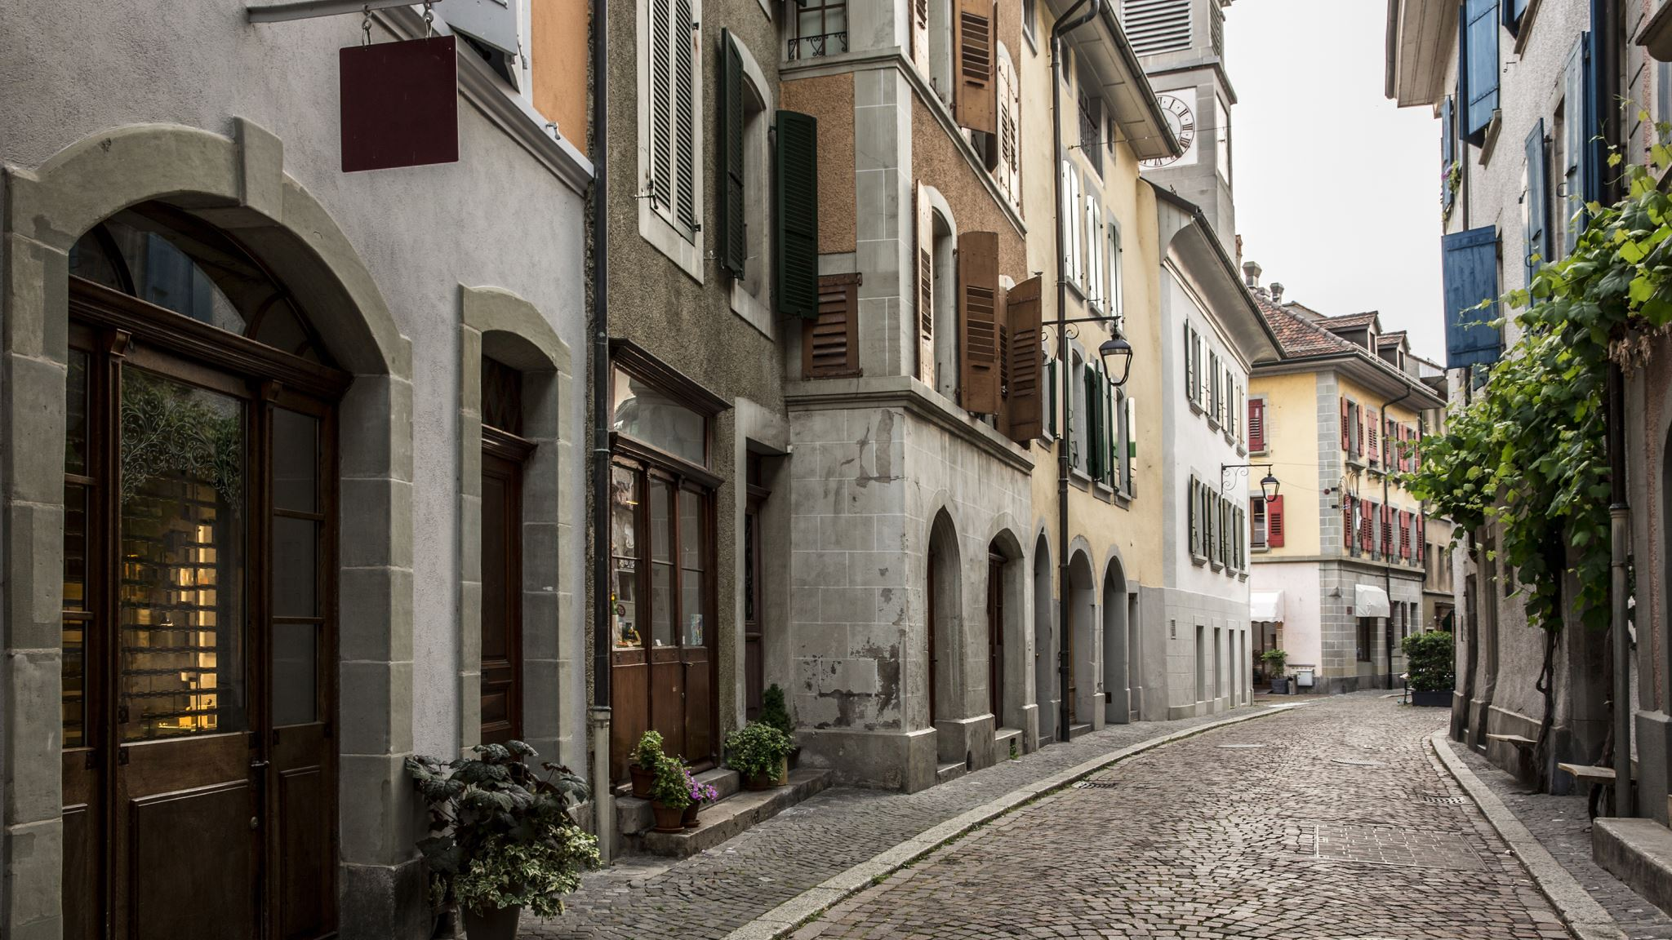
Italian fashion
Created by Yegor Botkov

Slide 2
Country
Italy is one of the leading countries in Fashion design, alongside France and the United Kingdom. Fashion has always been an important part of the country's cultural life and society, and Italians are well known for their attention to dress; la bella figura, or good appearance, retains its traditional importance.

Slide 3
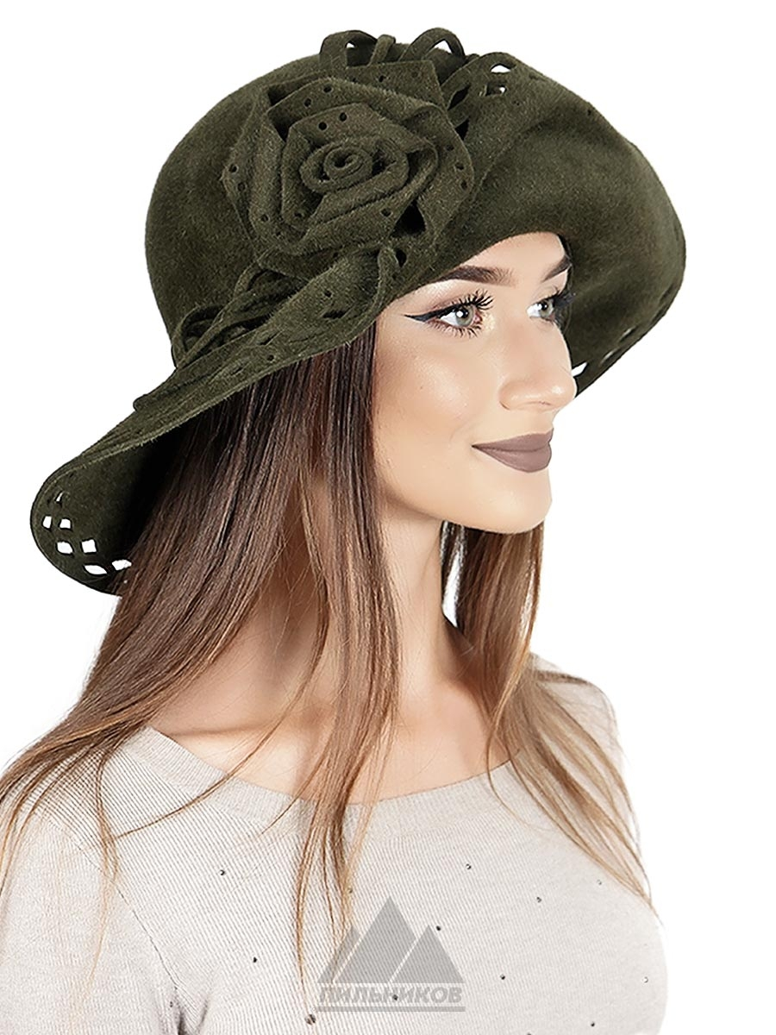
Fashion
Italian fashion became prominent during the 11th to 16th centuries, when artistic development in Italy was at its peak. Cities such as Rome, Palermo, Venice, Milan, Naples, Florene and Vicenza started to produce luxury goods, hats, cosmetics, jewelry and rich fabrics.

Slide 4
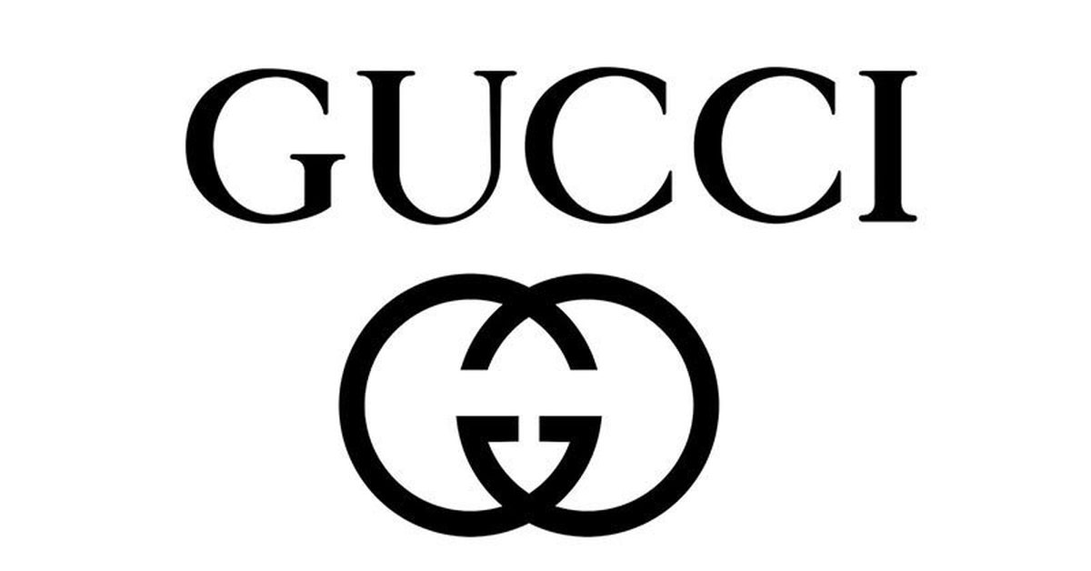
How was it made?
However, since the 1951–53 fashion soirées held by Giovanni Battista Giorgini in Florence, the "Italian school" started to compete with the French haute couture, and labels such as Prada and Gucci began to contend with Chanel and Dior.

Slide 5
What does it look like?
Fashion in Italy started to become the most fashionable in Europe since the 11th century, and powerful cities of the time, such as Venice, Milan, Florence, Naples, Vicenza and Rome began to produce robes, jewelry, textiles, shoes, fabrics, ornaments and elaborate dresses.
The Italian Catherine de' Medici, as Queen of France. Her fashions were the main trendsetters of courts at the time.

Slide 6
I like fashion in Italy, especially branded items like Gucci and Prada.

