Slide 1
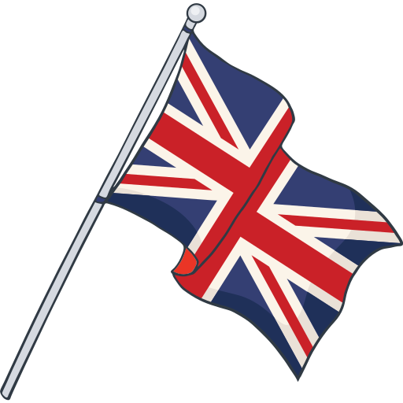
Fashion in the uk
created by Liza Bakhtina

Slide 2
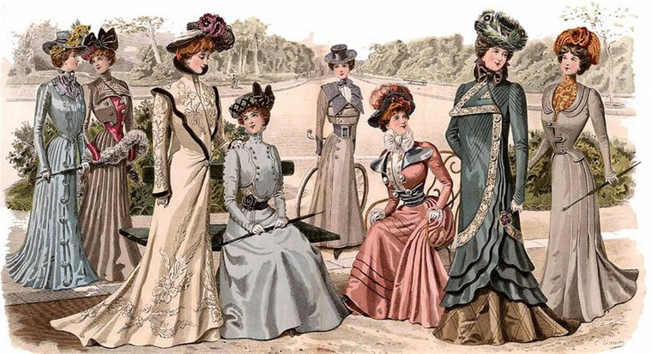
Fashion
Victorian style

Slide 3
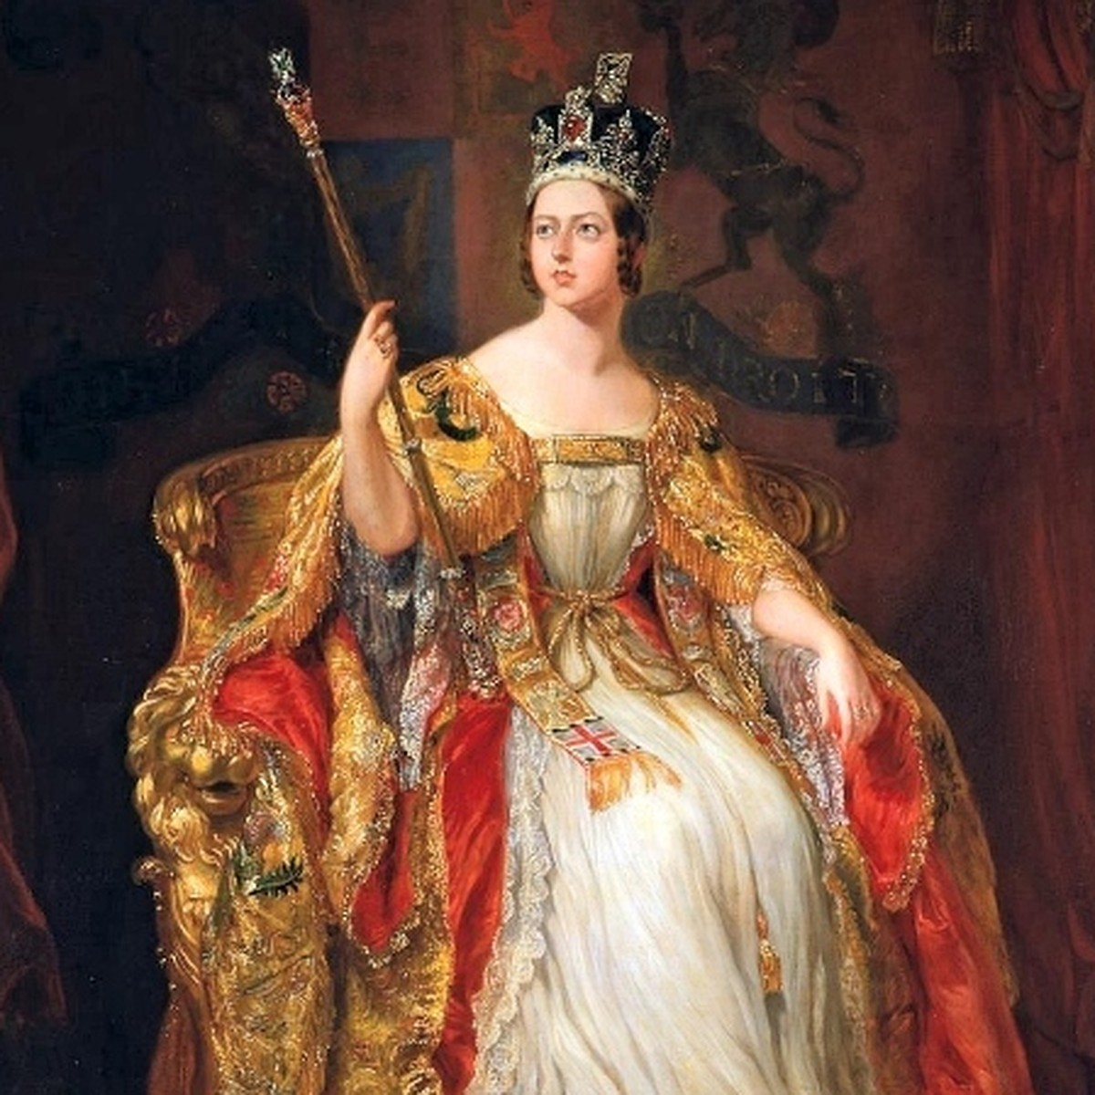
When did it start?
The Victorian style of clothing originated in the Victorian era. The Victorian Era was the reign of Victoria, Queen of Great Britain and Ireland and Empress of India, which lasted from 1837 to 1901.
Notes:
рейн

Slide 4
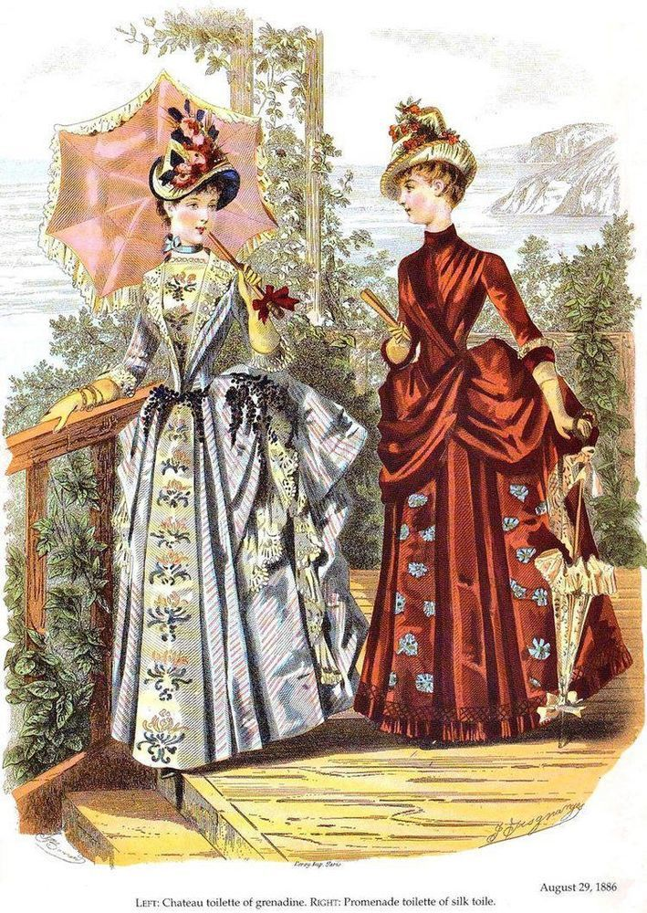
How was it made?
The Victorian style of clothing is characterized by the use of traditional materials such as velvet, silk, lace, brocade, as well as patterns in the form of flowers, leaves and geometric shapes. The fabrics were dyed in bright colors using aniline dyes. The dress was richly decorated with hand embroidery and lace.
Notes:
каректеррайз

Slide 5
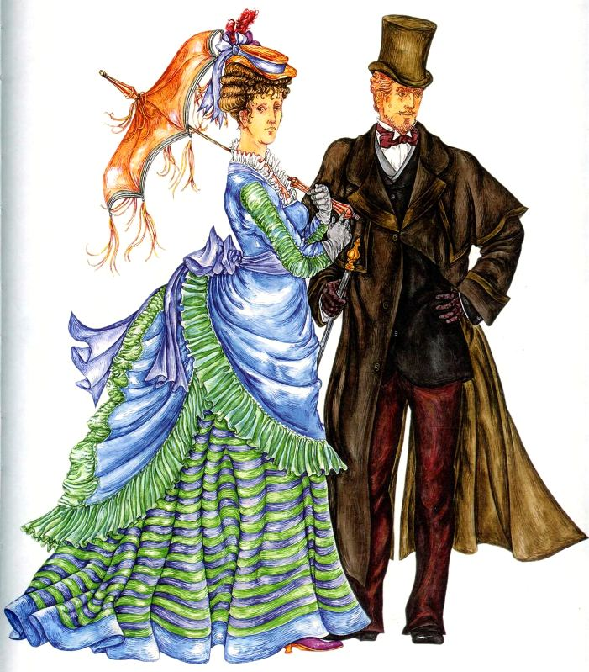
Was it for men, women or both?
Vectorian style clothes were worn by both men and women.

Slide 6
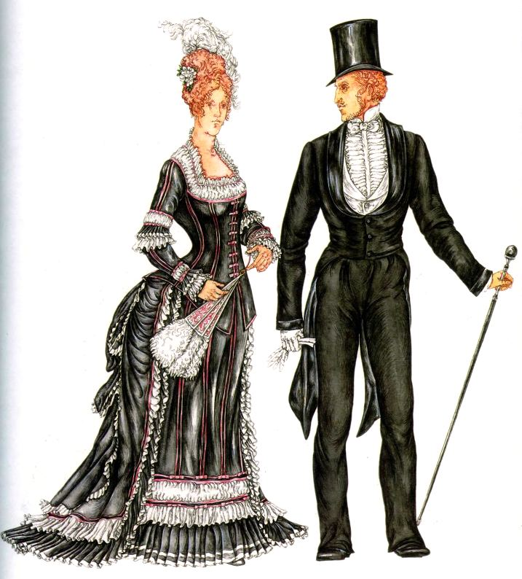
What did it look like?
Women's clothing included puffy skirts, corsets, high collars, ruffles, bows, as well as long gloves and umbrellas. Men's clothing usually included a suit, which consisted of a coat, trousers and a vest.

Slide 7
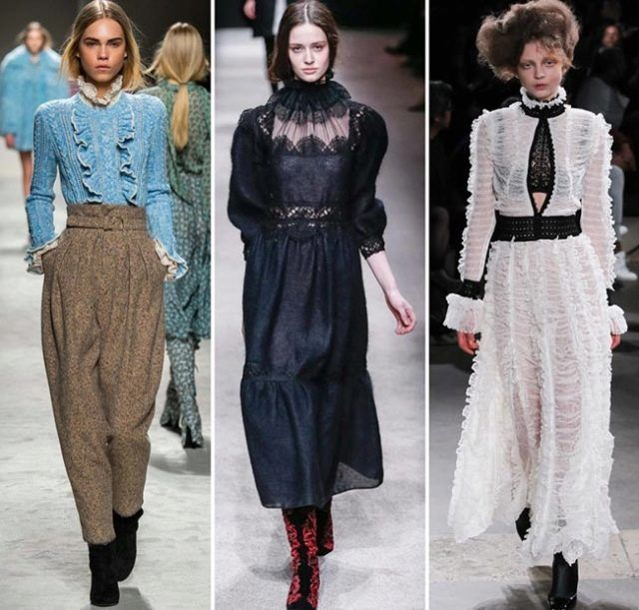
Is it still the fashion?
The Victorian style in modern fashion includes elements of the Victorian era, such as high collars, lace, corsets, puffy skirts and ruffles. However, modern designers often adapt these elements to the modern style by adding modern fabrics and styles. The Victorian style can also manifest itself in the choice of colors such as beige, white, black and burgundy shades.
The Victorian style is also evident in the decorations

Slide 8
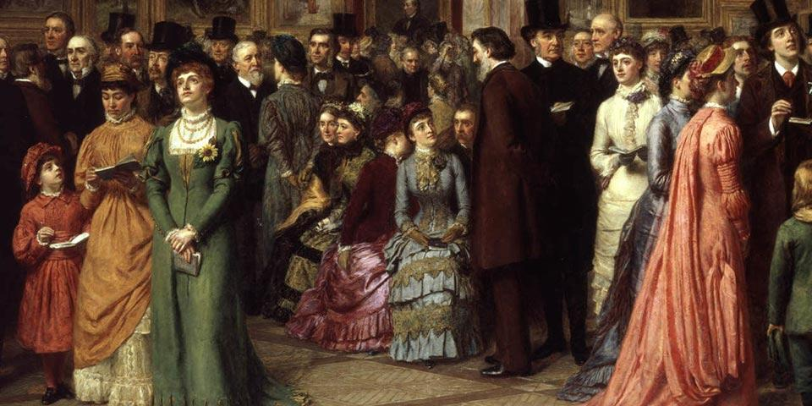
Do you like it?
I like the Victorian style. It is very beautiful and interesting. It also has a very interesting history.

Slide 9
thanks for the attention!

